Slide 1
Vision: Engage in creative collaboration to solve problems
Contact Information
Principal:
Veronica Coleman
Vcoleman@lbschools.net
Counselor:
Gerard Maliwat
Gmaliwat@lbschools.net
Linked Learning Pathway Coordinator:
Hajra Saeed
Hsaeed@lbschools.net
Sato Website:
https://sato-lbusd-ca.schoolloop.com/
Sato High School Choice Website:
https://sites.google.com/view/satoacademyofmathscience/home
Instagram: @sato_academy
Twitter: @SatoAcademy
Facebook: @SatoAcademy
Mission: Sato Academy of Math & Science empowers and equips students to be innovative collaborative problem solvers by immersing them in Biomedical Sciences and Engineering to generate solutions that improve health, happiness, and safety.
Home of the Dragons!
Nondiscrimination Statement The Governing Board desires to provide a safe school environment that allows all students equal access and opportunities in the district’s academic, extracurricular, and other educational support programs, services, and activities. The Board prohibits, at any district school, or school activity, unlawful discrimination, harassment, intimidation, and bullying of any student based on the student’s actual or perceived race, color, ancestry, national origin, nationality, ethnic group identification, ethnicity, age, religion, actual or potential marital, parental or family status, physical or mental disability, sex, sexual orientation, gender, gender identity, or gender expression; or association with a person or group with one or more of these actual or perceived characteristics.
1100 Iroquois Ave
Long Beach, Ca, 90815
562-598-7611
Pathway Requirements:
A 3.0 cumulative academic GPA from sixth & seventh grades.
Currently enrolled in Algebra I

Slide 2
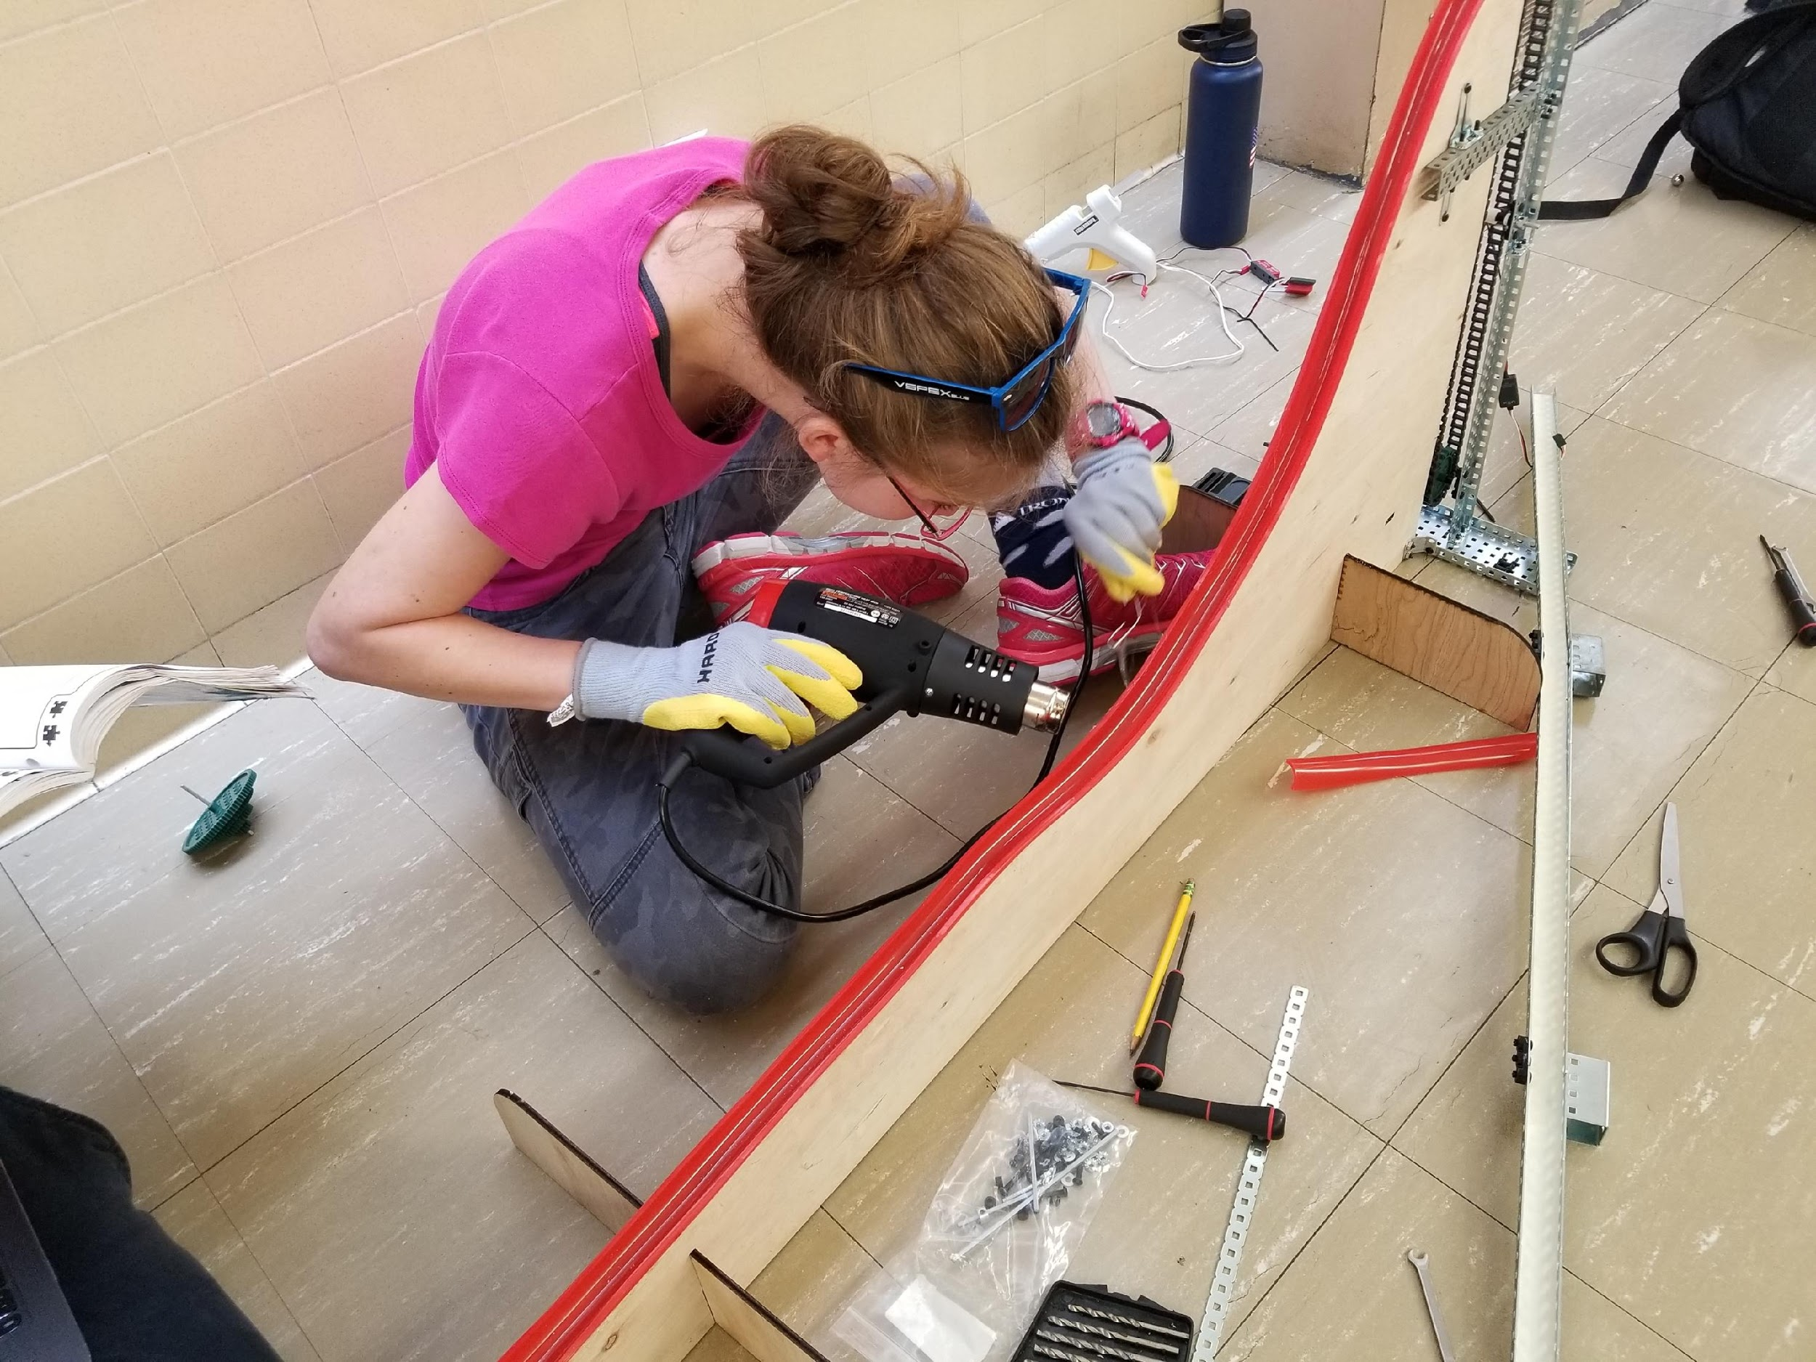
Who is a Sato Student?
9th Grade Course of Study
Sato Achievement Data
Math: Accelerated Geometry
Science: Medical Biology
Biomed: Human Body Systems
Engineering: Intro to Engineering and Design
English: Accelerated English
Foreign Lang: Spanish
PE: Kinesiology & Health
A Collaborative Communicator: can develop and lead conversations to work toward a common goal.
A Problem Solver: can persevere through difficult challenges.
A Creative Innovator: can create new ways to identify and implement solutions.
An Accomplished Industry Professional: has the skills, knowledge and thought processes to be adaptive and a productive citizen.
2019 SBAC Achievement
ELA: 95% Met + Exceeded
Math: 84% Met + Exceeded
Highest Growth of all LBUSD high schools from 8th grade to 11th grade in 2018-2019.
SAT Achievement
ELA: 89% Met
Math: 86% Met
Additional Course Highlights:
Principles of Engineering
Medical Interventions
Big History (History via a Science Lens)
Computer Integrated Manufacturing
AP Course Offerings: Biology, US History, Language, Literature, Calculus, Statistics, Psychology, Seminar, Research, Spanish, Government
Engineering Design & Development
Biomedical Innovations
CSULB & LBCC opportunities
New state-of-the-art buildings with Biomedical Labs & Engineering Workshops

